Slide 1
Business continuity and disaster recovery
Andik Susilo

Slide 2
Why Business Continuity/DR?
Loss of Data & Service
Cost of Disruption
Brand & Equity
Compliance
Organizations experience 4+ disruptions each year
Average cost of the disruption is $1.5M/hour
Loss of reputation is often irreparable
Clients want to partner with orgs that have BCDR in place
Recovery times range from 1hr to 9hrs
4 in 10 businesses do not reopen after a major disaster
Customer trust and brand severely impacted
Protection & recovery key tenet in most compliances
Downtime = Loss of business to competition or closure
* Source: EMC Digital Universe with Research and Analysis by IDC, 2014
Source: IDC: Measuring Cost of Downtime and Recovery Objectives Among U.S. Firms, IDC QuickPoll Survey July 2013 and Storage User Demand Study 2013
Source: Federal Emergency Management Agency (FEMA)
Notes:
Before we go into detail of Azure Site Recovery lets first understand why BCDR is critical to customers. We did a lot of research on this topic and some of the no's are eye opener e.g. Every Organization experience around 4 disruptions each year. Now thanks to nature we don’t get 4 Disaster situations every year – however another report talks about most of the time the disruption is caused by issues like Software failure, hardware failure, manual error, power failure/maintenances which are far more frequent then disaster situations like Fire, Flood, Earth quake etc. And for these disruptions recovery times are few hours.
There is another report which talks about cost of disruption to business and it varies from business to business – however the average cost was coming around 1.5M$/hour. This is huge cost for disruptions – However even bigger issue is 4 out of 10 businesses never reopen after disaster.
In addition each of these disruptions have severe impact on your company brand and reputation and last but not the least most of the compliances like ISO, HIPPA, FedRamp – Protection and Recovery is key tenant so if you want your application to be certified by any of these standards you need BCDR as many customers ask for these certifications as mandatory criteria.

Slide 3
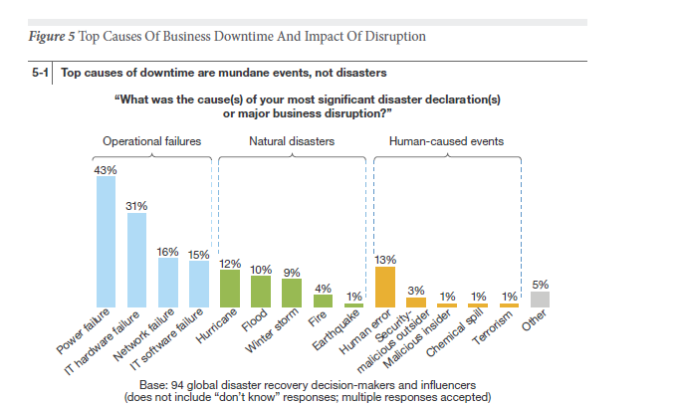
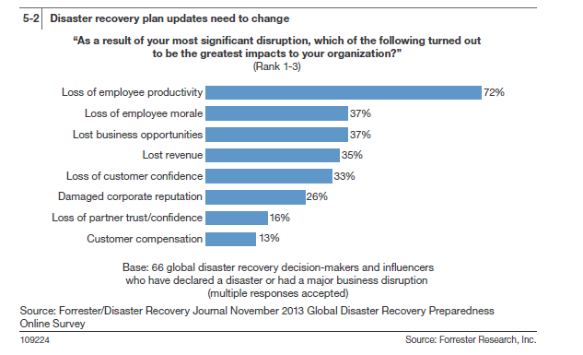
Most common cause for DR is Not natural disasters & Impact is severe

Slide 4
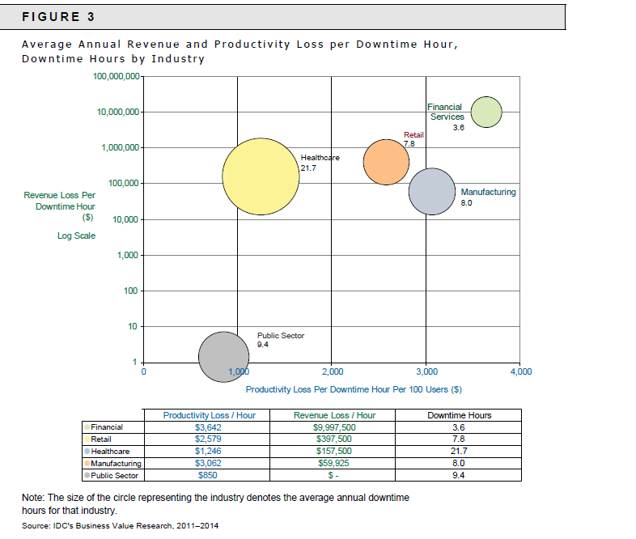
Every hour we save in RTO has direct ROI

Slide 5
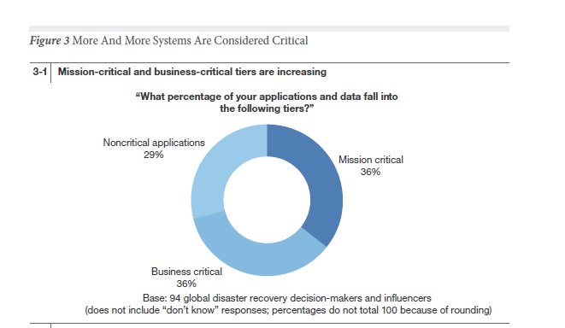
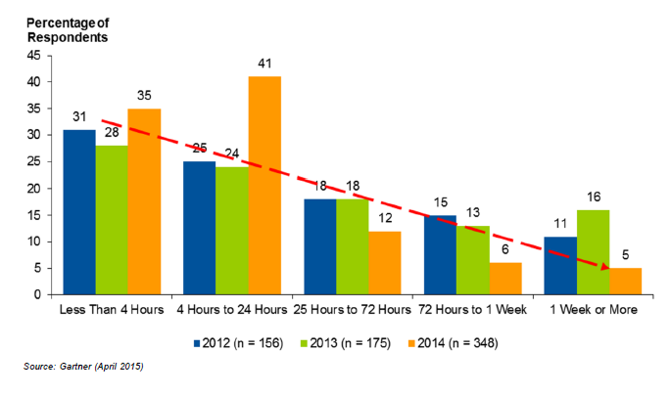
70-80% Workloads need DR and they can‘t get the desired RTO using offsite backup
Source: Forrester, 2013
A lot of Workloads are still using offsite Backup for DR - key target for ASR!

Slide 6
Business Continuity Challenges
Costs
Need to reduce the costs related to downtime
Disaster recovery solutions with synchronous replication are expensive
Monitoring
Constant monitoring of services can be challenging
Recovery
Manual recovery of the many virtual machines that compose services can be complex and time-consuming - procedures need to be documented and tested
Protecting Many Workloads
Some workloads that could benefit from protection go unprotected due to costs and complexity
Notes:
Now once your customer understand Why DR is critical and starts implementing the same – we face with following challenges. First one is cost – The cost to setup secondary DC, cost of expensive SAN array replication, Opex cost etc. Now inspite of spending so much money many of the DR solutions are not successful due to complexity associated with DR. First lets define what we mean by DR – here we are not talking about offsite backup where you send your data by tape or to cloud. If that is your DR mechanism if you hit any of the disruptions we talked about – it will take days for you to recover your applications. And not just millions of $ you’ll lose during that period – but your business may not even reopen.
So during these disruptions – every minute is critical and a DR solution optimizes your time to recover your applications. E.g. It automates what it takes to recover your application reliability. E.g. First brings AD/DNS kind of infrastructure components, followed by DB and finally App tier and front ends. Now in disaster cases recovery site infrastructure and addressing is different from primary site. So a DR Mgmt infrastructure helps you to automatically connect your applications to right network and assign right IP so that not only your application comes up but also able to server client request. Last but not the least how you monitor the health of protection.
The result of these challenges is many workloads go unprotected. We do not accept the current situation and started ASR with the vision of DR for every customer for every Application.

Slide 7

Safeguard your customer’s applications On-premises to on-premises protection with Azure Site Recovery
Microsoft Azure Site Recovery
Microsoft Azure Site Recovery
Communication Channel
vCenter /Physical
vCenter
Replication channel:
Replication Channel
Windows Server
Primary Site
Recovery Site
Windows Server
VMware/Physical
Primary Site
Recovery Site
VMware
Key features include:
Automated VM protection & replication
Remote health monitoring
Customizable recovery plans
Integration with existing investments
Support for heterogeneous environments
No-impact recovery plan testing
Orchestrated recovery of tiered applications
Notes:
Azure Site Recovery is a Disaster Recovery service provided from Microsoft Public Cloud Azure. And support different DR scenarios e.g. The most common/traditional DR scenario where a customer have 2 sites referreed as Primary and Secondary sites say Contoso having sites in NewYork and Seattle. Microsoft Azure Site Recovery helps to setup and manage DR between these two sites. The key point of this architecture is here Azure Site Recovery offers you DR Management from the cloud – however the data for your application travels between your own sites on your own network. So Azure site recovery has no knowledge of what applications you are running and any data as that information never goes to Azure.
And importantly as customers can have heterogeneous environments we support both Hyper-V, VMWare as well as Physical environments DR using ASR today.
Now this same scenario can be used by Service Providers where they are hosting a set of workloads on their primary data center say Chicago and want to setup DR with another data center in NewYork to offer its customers DR as a Premium service.

Slide 8
Safeguard your customer’s applications On-premises to Microsoft Azure protection with Azure Site Recovery
Microsoft Azure Site Recovery
Microsoft Azure Site Recovery
Orchestration & Replication
Orchestration & Replication
vCenter / Physical
GA
Primary Site
Windows Server
Primary Site
VMware/Physical
Support for heterogeneous environments
No-impact recovery plan testing
Orchestrated recovery of tiered applications
Key features include:
Use Azure as your DR site
Automated VM protection & replication
Remote health monitoring
Customizable recovery plans
Notes:
Now as we talked in a DR project setting up and managing secondary site is the primary cause of cost and complexity. So with Azure Site Recovery we released another DR scenario where you don’t need to setup a secondary site for DR – instead you can leverage Azure as your DR site. Our customers love this as this opens up so many opportunities for DR – so many new customers and applications can now afford DR. Today we have this scenario available for Hyper-V workloads and this year we are also enabling this for Vmware/physical workloads.
For both OnPrem to OnPrem as well as OnPrem to Azure we provide the same DR management value prop for our customers.

Slide 9
ASR: Multiple Scenarios, One Solution
Disaster Recovery | Migration| Dev/Test
Automated VM level Replication and Failover
Continuous log based replication (Not snapshots!)
RPO of seconds and RTO of minutes
30 seconds, 5 mins, 15 minutes
Planned and unplanned failover
Orchestrated Recovery Plans for Disaster Recovery
Failback support
No impact DR Drills with Test Failover
Migrate to Azure from anywhere
Create on-demand test copies in Azure

Slide 10



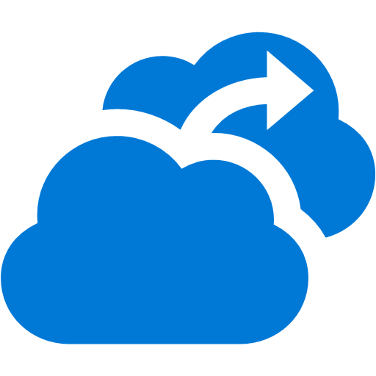
ASR DR to Azure scenarios architecture
vCenter
_{(Optional)}
Process & Config Server
VMware VMs & Physical Servers
VMM
_{(Optional)}
Site Recovery Vault
Hyper-V VMs
Process Server – Used for Discovery, Caching, Compression & Encryption
ASR Provider – Captures all data writes from memory or VHD differencing disk

Slide 11

ASR Hero Scenario – Typical 3 Tier Web App
Azure Site Recovery
DR Orchestration
DR Orchestration
SQL Backend
ASR Replication
Azure Storage
App Front End
App Tier
ASR Replication
Active Directory
ASR Replication
Primary Site
Azure
Above shows DR to Azure however same Hero scenario is applicable for On Premise to On Premise DR.
Notes:
Now a common question is what kinds of workloads we can leverage ASR for DR into Azure. ASR hero scenario is a typical 3 tier App DR.

Slide 12
ASR Hero Scenario - with AD Replication and SQL Availability Group
Azure Site Recovery
DR Orchestration
DR Orchestration
SQL Backend
IaaS VM
SQL Availability Group
App Tier
App Front End
ASR Replication
Azure Storage
Active Directory
AD & ASR Replication
IaaS VM
S2S VPN
Azure
Primary Site
Above shows DR to Azure however same Hero scenario is applicable for On Premise to On Premise DR.
Notes:
Another common hero scenario is where a customer is using SQL Always-ON for DB DR. We have worked with SQL PG to enable single click Application failover using ASR. Here SQL replication is used to replicate SQL DB changes to Azure IaaS VM running SQL Always On. However for Web and App Tier either replica or Scout channel is used to replicate changes.
Using both these hero scenarios we can do DR for any workloads – I’ll be doing a deep-dive on workloads

Slide 13

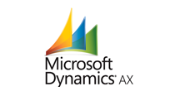
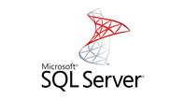
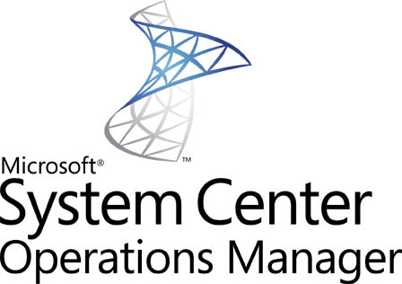
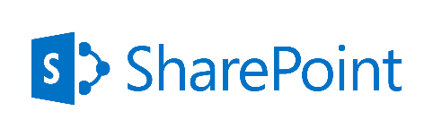
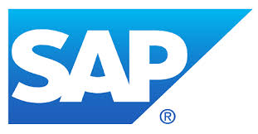


Differentiate with Unmatched App Support
Active Directory | IIS | RDS/VDI | File Server
Only Disaster Recovery Solution backed by Microsoft Support for Microsoft Applications
For SA Customers: Zero additional license charge for DR of 1st party workloads
VSS integration, App consistent, Multi-VM

Slide 14
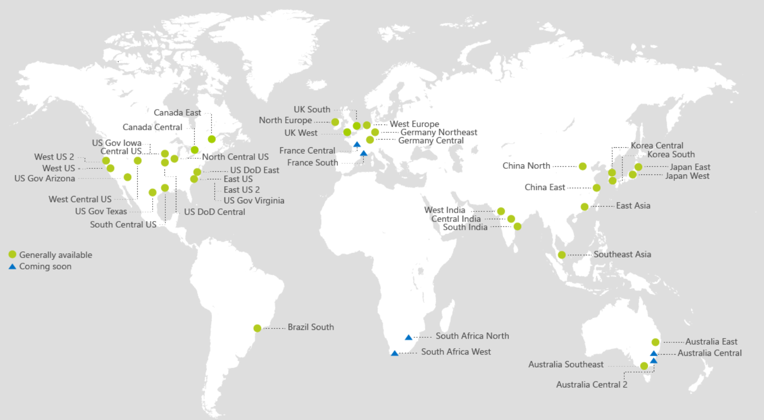
Available in all public regions World Wide, incl. All US regions

Slide 15
On Prem to Azure DR - FAQs
Azure does not support VHDX. Does ASR works with VHDX?
Yes. ASR converts VHDX to VHD for failover. On failback, VM continues to use VHDX.
Does ASR supports Gen2 VMs?
Yes. ASR converts a Gen-2 VM to Gen1 for failover. On failback, VM continues to use Gen2 capabilities.
What are the limits on disk size?
Each disk up to 1TB (1023 GB). And one VM can have maximum of 31 VHDDs So about 32 TB VM can be supported. Now even 64 disks VMs are available with Azure.
Does ASR works with Linux VMs?
ASR supports all the Operation systems supported in Azure, which includes most flavors of Windows and Linux

Slide 16
On Prem to Azure DR - FAQs
What about network bandwidth?
ASR supports working with WAN Optimizer Riverbed as well as Express route.
Can I control the network traffic used for replication?
For Hyper-V to Azure - Yes you can use the network throttling on the host MARS agent to control how much network bandwidth is used for replication.
For VMware to Azure – You can leverage Windows QoS on Process Server Machine to control traffic for replication.
Can I send replication traffic over ExpressRoute?
Yes. You can use Express Route to send your replication traffic in a secure and fast manner. However its not mandatory. See here
Is it mandatory to have S2S VPN for ASR?
Its not mandatory to have S2S VPN we work over simple internet connectivity also. However if you have S2S we also work with that. A detailed blog on DR to Azure networking is available here
How do you connect to VMs post failover to Azure?
You should enable RDP for your VMs On Premises. Then post failover if you have a S2S VPN connection you can connect to them in the same way. Or if you want to access them over internet – we have a script available with ASR integration with Azure automation to enable RDP endpoint.

Slide 17
On Prem to Azure DR - FAQs
Can I retain IP after failover to Azure?
Yes. ASR allows you to specify a IP for failover VM.
How do I route client requests to failover Application?
ASR works with Azure Traffic Manager to help clients requests routed to failover application. Recovery plan scripting (Using Azure automation) can also be used for DNS updates.
Can I failover a partial site to Azure and connect back to OnPrem site?
Yes. Using Site to Site VPN you can connect failed over Application in Azure back to On-Premise components.
Do I pay for running VMs for ASR protection.
ASR is designed for Public Cloud DR. Therefore in steady state we replicate changes to storage and you don’t need to pay for any Azure IAAS VM charges (Big competitive advantage). When you failover – ASR automatically creates IAAS VMs and then you pay for IAAS charges for the period you run VMs in Azure.
My OnPrem VM has multiple drives C:, D:, E: etc. When VM failover to Azure how do I retain these drive letters?
Please set your SAN Policy (For Hyper-V workloads) as ON inside Guest On Premise and then Azure will retain the drive letters. See here . For VMWare workloads you don’t need to do anything we retain the drive letters for you.
Is Exchange supported for DR to Azure?
Yes Azure IAAS team has published Exchange support.

Slide 18
On Prem to Azure DR - FAQs
What Recovery Time Objective (RTO) ASR supports?
ASR supports minutes of RTO which is industry standard. Actual failover time depends on type of VMs. Best way to measure is run TFO and use ASR Job reports to view where time is spent as ASR provides time taken for each activity.
What Recovery Point Objective (RPO) ASR supports?
ASR supports near sync RPO (In seconds) for Azure target (Best in public cloud DR). Actual RPO depends upon the data change rate and available bandwidth to send this data to Azure.
Does ASR supports failback?
Yes – you can failback to on-premises.
Is there a tool to help me plan capacity
Yes we have an excel sheet (See RDP Kit) as well as Capacity Planner tool.
What are the limits for ASR?
As a customer you can protect hundreds/thousands of VMs for DR to Azure. However within a recovery plan we support a maximum of 50 VMs. As customers use Recovery plans for Applications and have different recovery plans for different applications.
Each Azure subscription comes with a set of limits on cores etc. Use TFOs to validate if you need to increase the default values.

Slide 19

Azure Site Recovery: The Complete Disaster Recovery Solution
OMS
Part of a Broader Cost Effective Management Story
Any Cloud
VMWARE, HYPER-V, Physical, AWS*
DR to Azure
DR to Alternate Site
+
Any OS
Windows
Linux
App Aware
SharePoint | SQL Server | Exchange | SAP | Oracle | and more..
Cloud On-Ramp
Disaster Recovery | Migration| Dev/Test
Power of Azure
Hyper-Scale| Enterprise Grade | Hybrid | Agile
Notes:
Have first slide that Dr is important
Is there data on backup customers who use backup of DR.
How much is currently covered by DR products
Show the market size
Refer to SRM quotes on DR vs. backup
Quote Levi’s /chevron
Add a slide on Power of Azure
Show single slide showing Any to Any (Add Windows/Logo)
App workload, talk up MS support, show logo
Add partner slide
Get Karl: inputs on what succeeds
Where is it easy to make sale
Top objection handling
Sweet spot for selling
Where to go for more information and support
http://bcdr
Ryan: Call for action
Expand the backlog slide

Slide 20
Azure Site Recovery Use Cases
Disaster Recovery
Single click Application recovery
Compliance Assurance without impacting Production
Disaster Avoidance – Hurricane warning
Failover during real disasters – Fire, Earthquake etc.
Migration
No impact on production during replication – Just minutes of downtime during cutover
Test before migration using Test failover
Free Migration
Dev/Test environment
Using Test Failover get an identical copy of your production environment
Use this for testing different scenarios like Patch Tuesday, New release testing
Deploy new patches/bits to production with confidence.

Slide 21
References –
Getting Started with On-premises to Azure DR
Getting started for Branch office to Azure DR
Getting Started for VMware to Azure
Getting Started with On-premises to On-premises DR using Replica
Getting Started with On-premises to On-premises DR using SAN replication
Networking white-paper
Monitoring and Troubleshooting
Site Recovery Forum

Slide 22

© 2015 Microsoft Corporation. All rights reserved. Microsoft, Windows, and other product names are or may be registered trademarks and/or trademarks in the U.S. and/or other countries.
The information herein is for informational purposes only and represents the current view of Microsoft Corporation as of the date of this presentation. Because Microsoft must respond to changing market conditions, it should not be interpreted to be a commitment on the part of Microsoft, and Microsoft cannot guarantee the accuracy of any information provided after the date of this presentation. MICROSOFT MAKES NO WARRANTIES, EXPRESS, IMPLIED OR STATUTORY, AS TO THE INFORMATION IN THIS PRESENTATION.

